Slide 1
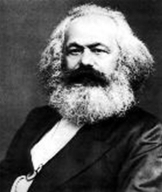
Communism evolved from the idea that workers have rights and should enjoy an equal say in the government. These ideas were developed by Karl Marx.

Slide 2
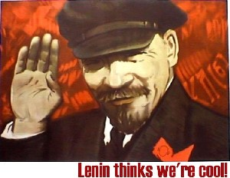
Communism was brought to Russia by Vladimir Lenin, leader of the Russian Revolution and a Marxist believer.

Slide 3
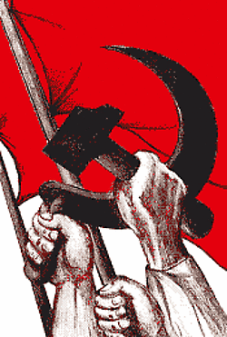
Lenin lead the Russian Revolution, urging Russians to rise as one, to work together for peace and prosperity.

Slide 4
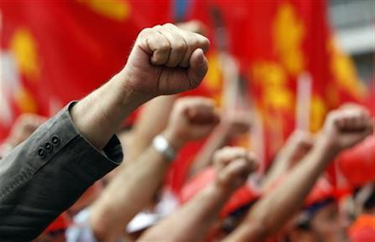
The people responded, the government was overthrown, and communism came to power.

Slide 5
The idea was that everyone would work together for “the greater good” and share the wealth.

Slide 6
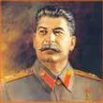
Joseph Stalin, who succeeded Lenin, had a different concept of sharing power. He shared it all … with himself.

Slide 7
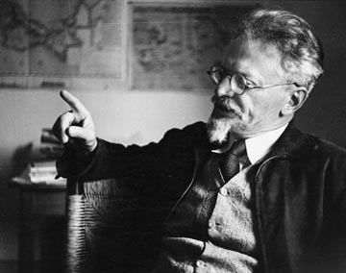
Stalin’s idea of utopia included ridding himself of everyone who opposed him, including his chief rival for power, Leon Trotsky, an intellectual and Marxist purist, whom Stalin exiled.

Slide 8
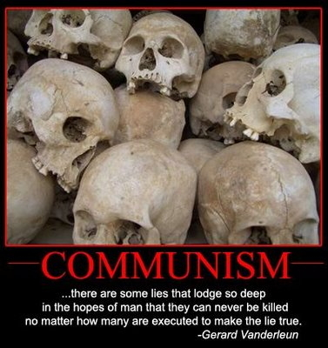
Considering what happened to millions of others who opposed Stalin, Trotsky got off easy.

Slide 9
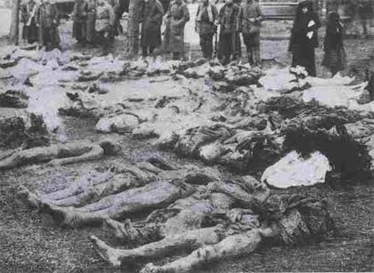
Marx’s ideal of the people having the power twisted into the Red Terror, the most destructive political movement in history.

Slide 10
But at time, the rest of the world didn’t know.
Actually, at this time, the concept of Communism was growing in popularity across Europe.
This filled writer George Orwell with dread. He was convinced Communism had a dark side, and he was driven to find a way to demonstrate this to the public before countries like his native England embraced this form of government.

Slide 11
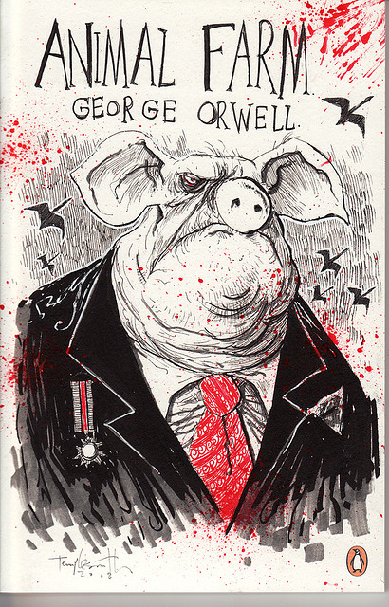
So he wrote Animal Farm, A Fable.

Slide 12
WW#1: FABLE
Definition: a short story, typically with animals as characters, conveying a moral
Synonym: parable
Antonym: mystery

